Slide 1
TP02: Microbusiness Density Forecasting
Team 16: James Davies, Chai Hibbert, Alexander Rippey, Solomon Itany
Notes:
https://github.com/Jedavies2307/ML2_FinalPresentation

Slide 2
Background
Competition Host: GoDaddy
GoDaddy is the world’s largest services platform for entrepreneurs, specifically providing domain registration and web services
GoDaddy often provides services for online microbusinesses (<10 employees)
Desire to know which counties to focus on
Desire to understand their clientele better
Notes:
Solomon

Slide 3
Problem Statement
Wider Internet availability and adoption since the 1990s has greatly increased the number and density of microbusinesses
GoDaddy has asked us to develop and train a model to predict the monthly density of microbusinesses per county across the United States
Since the number of microbusinesses is highly volatile, data is reported monthly
Many microbusinesses are online-only sole proprietorships
Unclear how wealth/income, education, immigration, and other drivers affect entrepreneurial ambition
Understand what drives microbusiness density
Notes:
Solomon

Slide 4
Critiques of Other Models
Competition is Currently Ongoing
Notes:
Solomon

Slide 5
Data Wrangling
5 files (train, test, revealed test, sample submission, census starter) from Kaggle
Train.csv -> 122,266 rows, 7 columns
Test_revealed.csv -> 25,081 rows, 7 columns
Features included:
CFIPS: unique ID for each county (County Federal Information Processing System)
Active: raw count of microbusinesses in the county
Microbusiness density: microbusinesses per 100 people +18 y/o in the given county
Y Target
Supplemental Census Data: X Features
New value for each year, 2017-2021
Broadband internet access (% households), Median household income ($), Bachelor’s or higher attainment rate (%), Foreign-born rate (%), IT Worker rate (%)
Notes:
Chai

Slide 6
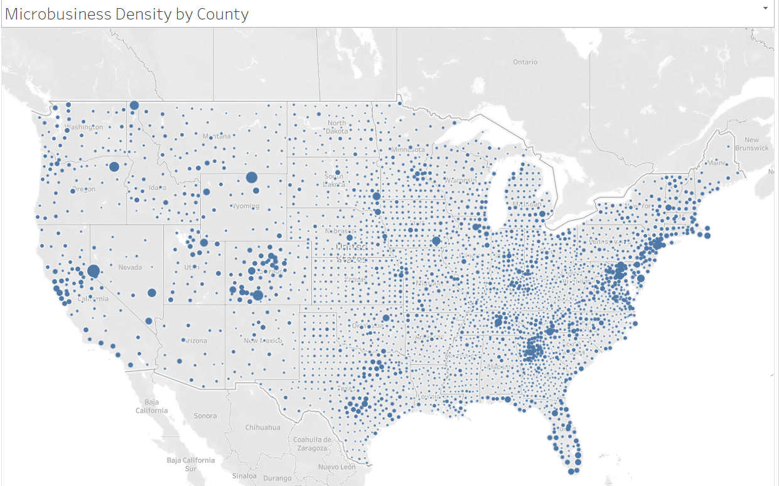
Notes:
Alexander

Slide 7
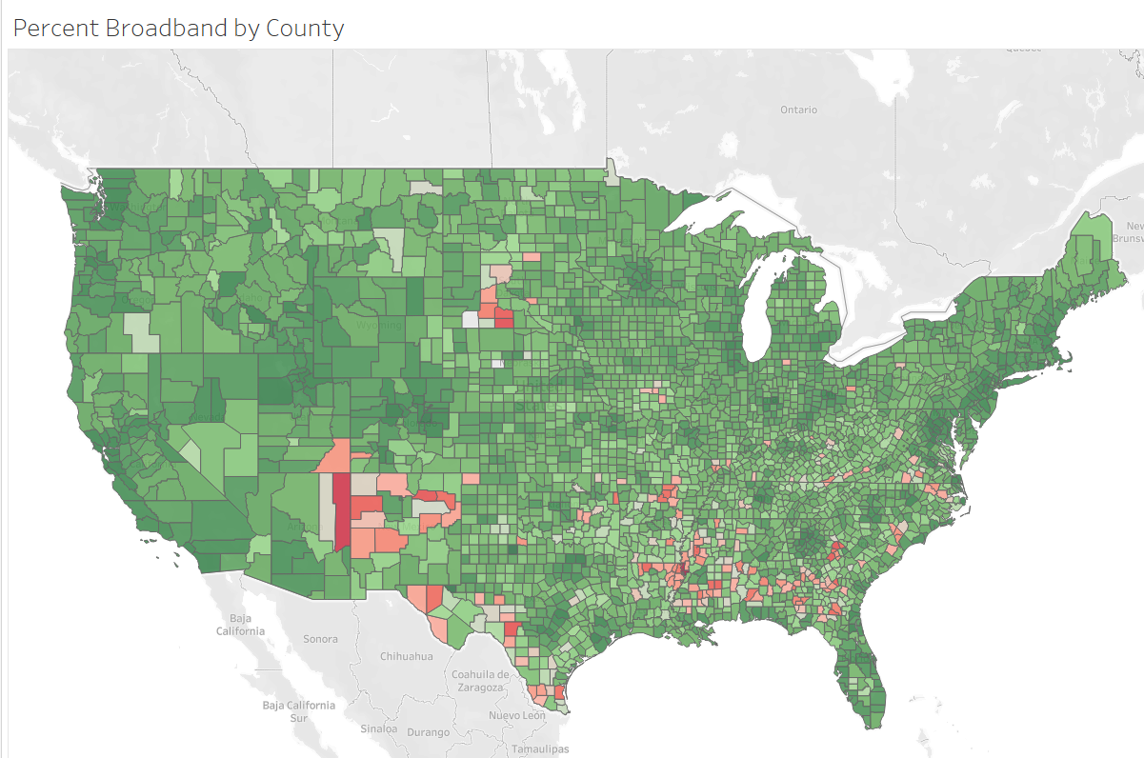
Notes:
Alexander

Slide 8
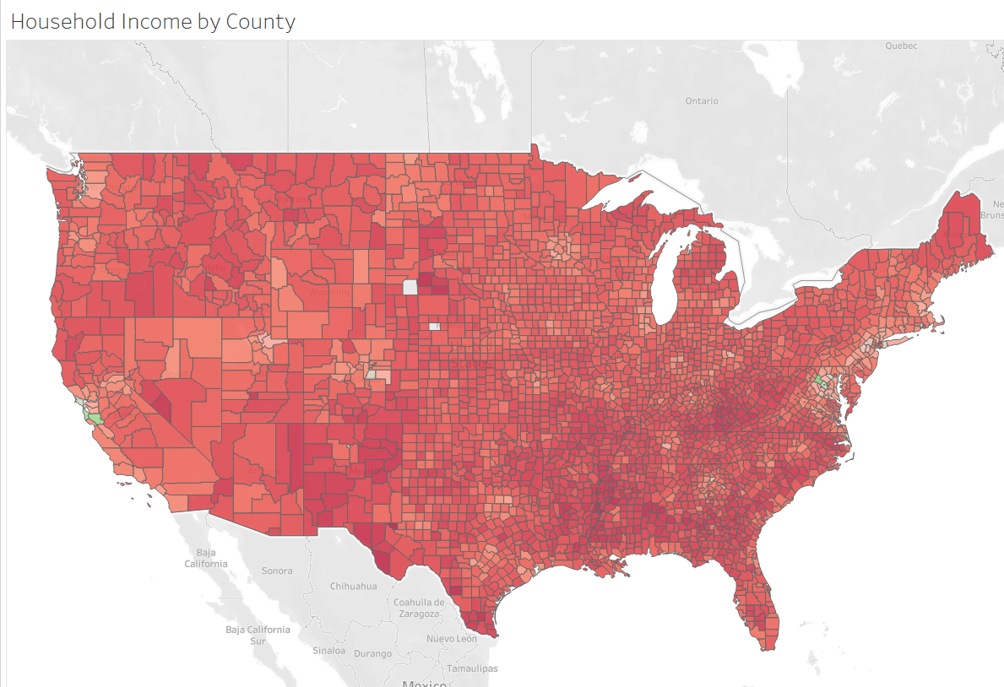
Notes:
Alexander

Slide 9
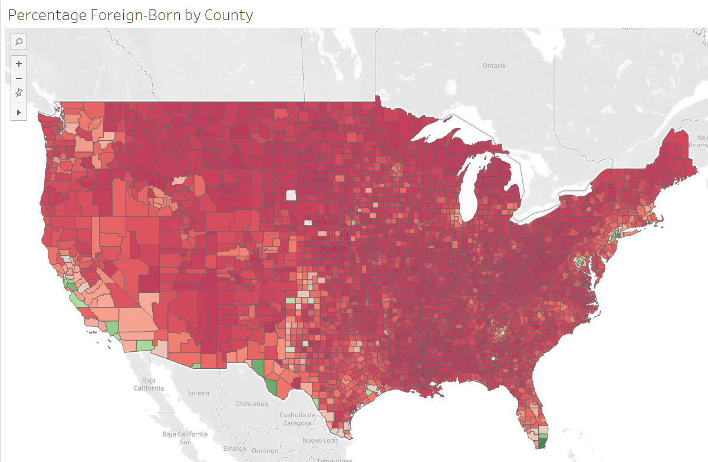
Notes:
Alexander

Slide 10
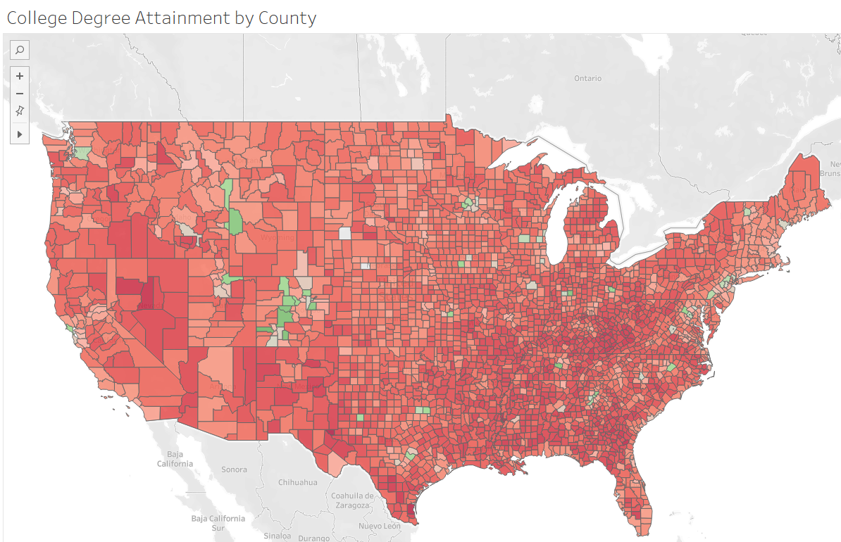
Notes:
Alexander

Slide 11
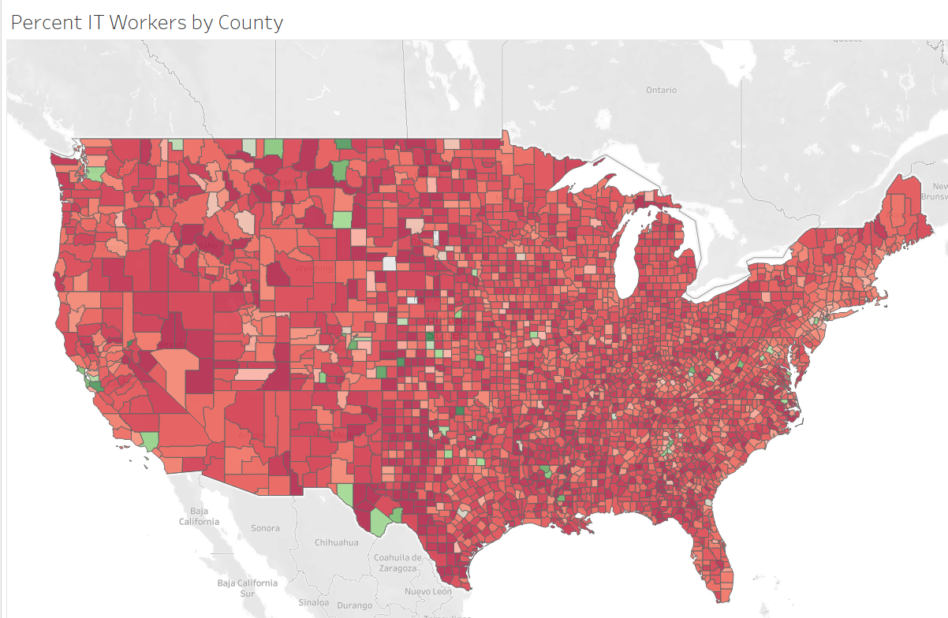
Notes:
Alexander

Slide 12
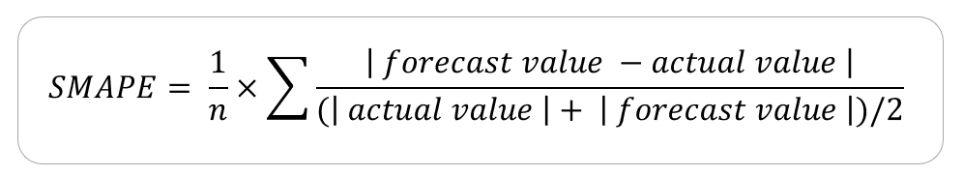
Error Metric: Symmetric Mean Absolute Percent Error
Asymmetry in MAPE
If Actual > Predicted, max MAPE = 100%
If Actual < Predicted, max MAPE = ∞
*100%
Case | Actual | Predicted | Abs Difference | Error Metric
Actual > Pred, MAPE | 10,000 | 100 | 9,900 | MAPE = 99%
Actual < Pred, MAPE | 100 | 10,000 | 9,900 | MAPE = 9,900%
Actual > Pred, sMAPE | 10,000 | 100 | 9,900 | sMAPE = 196%
Actual < Pred, sMAPE | 100 | 10,000 | 9.900 | sMAPE = 196%
Notes:
Alexander

Slide 13
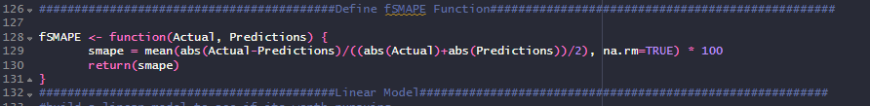
SMAPE in R
Notes:
James

Slide 14
Data Modeling
See R Code
Notes:
James

Slide 15
Solution
Ex: sMAPE of 5% means the average prediction was 5% off (does NOT matter if it’s an over/underestimation)
Linear regression sMAPE = 44.08%
XGBoost sMAPE (initial) = 2.28%
XGBoost sMAPE (finely-tuned Learning Rate ) = 2.25%
Power of XGBoost
Notes:
Alexander

Slide 16
Importance of X Features
Best feature
pct_college_2021 -> gain = 0.188
Worst features
median_hh_inc_[year] -> gains range between 0.001-0.004
Other useful features
Month (gain = 0.070), year (0.127), pct_bb_2017 (0.101)
Issues with correlation of the X features?
Useful to have X features for every county for each year?

Slide 17
Future Modeling
Standardize variables
Deal with NULLs, outliers differently
Kaggle competition allowed outside X features, though we did use additional features Other useful features may be:
Age (mean, median, binned)
Expansion of education variable
% Married vs. unmarried
2020 Election results (capture political ideology)
Unemployment rate
% Urban
Protected classes?
Race / Ethnicity
Gender
Religion
Ethical? Legal?
Notes:
Alexander

Slide 18
Questions
Thank you for your time!

